Slide 1
Diyala University
College of Engineering
Department of Civil Engineering
Water Resources Engineering
for 4th Class
By
Dr. Saad Shauket Sammen

Slide 2
Soil – Water Relationships
Introduction
Both soil and water are essential for plant growth. The soil provides a structural base to the plants and allows the root system (the foundation of the plant) to spread and get a strong hold. The pores of the soil within the root zone hold moisture which clings to the soil particles by surface tension in the driest state or may fill up the pores partially or fully saturating with it useful nutrients dissolved in water, essential for the growth of the plants. The roots of most plants also require oxygen for respiration. Hence, full saturation of the soil pores leads to restricted root growth for these plants. Since irrigation practice is essentially, an adequate and timely supply of water to the plant root zone for optimum crop yield, the study of the inter relationship between soil pores, its water-holding capacity and plant water absorption rate is fundamentally important.

Slide 3
Soil – Water System
Soil is a heterogeneous mass consisting of a three-phase system of solid, liquid and gas. Mineral matter, consisting of sand, silt and clay and organic matter form the largest fraction of soil and serves as a framework (matrix) with numerous pores of various proportions. The void space within the solid particles is called the soil pore space. Soil is a complex mass of mineral and organic particles. The important properties that classify soil according to its relevance to making crop production (which in turn affects the decision making process of irrigation engineering) are:
Soil texture
Soil structure

Slide 4
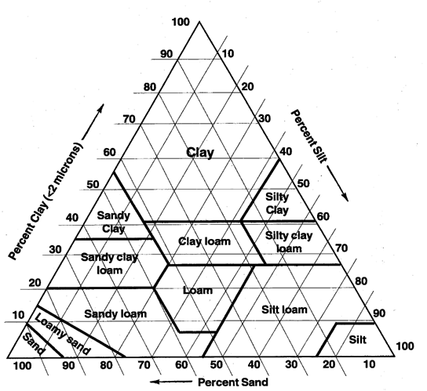
Soil Texture
This refers to the relative sizes of soil particles in a given soil. According to their sizes, soil particles are grouped into gravel, sand, silt and day. The relative proportions of sand, silt and clay is a soil mass determines the soil texture. Figure below presents the textural classification of 12 main classes as identified by the US department of agriculture.
Soil Textural Triangle

Slide 5
Open or light textural soils: these are mainly coarse or sandy with low content of silt and clay.
Medium textured soils: these contain sand, silt and clay in sizeable proportions, like loamy soil.
Tight or heavy textured soils: these contain high proportion of clay.
Soil Structure
This refers to the arrangement of soil particles and aggregates with respect to each other. Aggregates are groups of individual soil particles adhering together. Soil structure is recognized as one of the most important properties of soil mass, since it influences aeration, permeability, water holding capacity, etc. The classification of soil structure is done according to three indicators as:-

Slide 6
Type: there are four types of primary structures-platy, prism-like, block like and spheroidal.
Class: there are five recognized classes in each of the primary types. These are very fine, fine, medium, coarse and very coarse.
Grade: this represents the degree of aggradation that is the proportion between aggregate and unaggregated material that results when the aggregates are displaced or gently crushed. Grades are termed as structure less, weak, moderate, strong and very strong depending on the stability of the aggregates when disturbed.
Volume and Mass Relationships in Soils
Many soil – water properties can be defined relative to the elemental soil volume as shown in figure below. This is a volume of soil which has been separated into its air, water, and solid constituents. Relationships for mass indicated on the right-hand side of the soil volume.

Slide 7
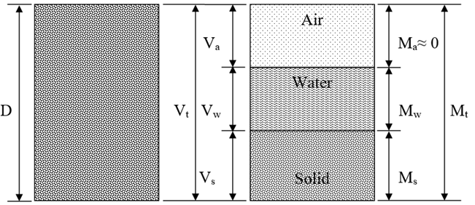
The mass of air, M_{a} , is assumed negligible. The mass of water and solids are indicated as M_{w} and M_{s} , respectively. The total mass is shown as M_{t}.
The volume relationships are indicated on the left-hand side of the soil volume in figure below. Va is the volume of air which can be a significant percentage of the soil volume under field condition. Vw represents the volume of water, and Vs the volume of solids. The volume of pores, designated by Vp, is the sum of the volume of air and water. The total volume is normally termed the bulk volume and designated as Vb.
Schematic diagram of a soil block as a three-phase system

Slide 8
Various soil – water properties may be defined in a number of different ways. The following listing indicates the definitions for soil – water properties which may be used.
1- Porosity (n):- is the ratio of the voids volume to the total volume.
porosity in soils varies between 0.3 (sands, silts) to 0.45 (clays), and is largely determined by the soil density:
2- Void Ratio (e):- is the ratio of the volume of voids (or pore spaces) to the volume of solids.

Slide 9
It should be noted that the value of porosity n is always less than 1.0. But, the value of void ratio e may be less, equal to, or greater than 1.0.
3- The specific weight (or the unit weight) of the solid particles is the ratio of dry weight of the soil particles Ws to the volume of the soil particles Vs, i.e., Ws/Vs.
4- Bulk Density:- is the ratio of the dry soil weight which keep in normal structure to the total volume for this weight
5- Real Density:- is the ratio of the dry soil weight which keep in normal structure to the soil volume for this weight
Relative density: - is the ratio of the material density to the water density

Slide 10
Now available water content can be express as:-
Percentage by volume
P_{v} = (V_{w}/V)× 100%
Percentage by dry weight P_{w} = (w_{w}/w_{s}) × 100%
Percentage by wet weight P_{ww} = (w_{w}/w) × 100% (w = w_{w}+w_{s})

